Slide 1


Slide 2

Machine Learning Overview
Machine learning definition
Machine learning types
Machine learning types
Other key machine learning method
Common machine learning algorithms

Slide 3
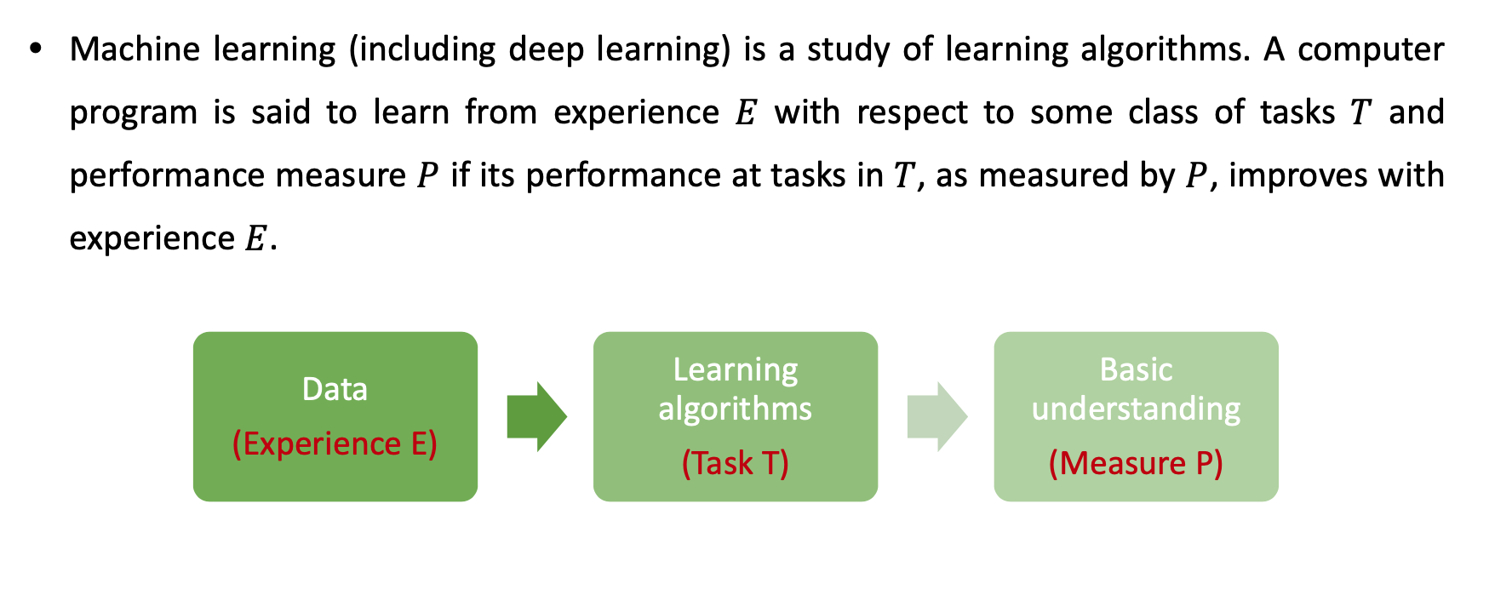
Machine learning algorithms

Slide 4
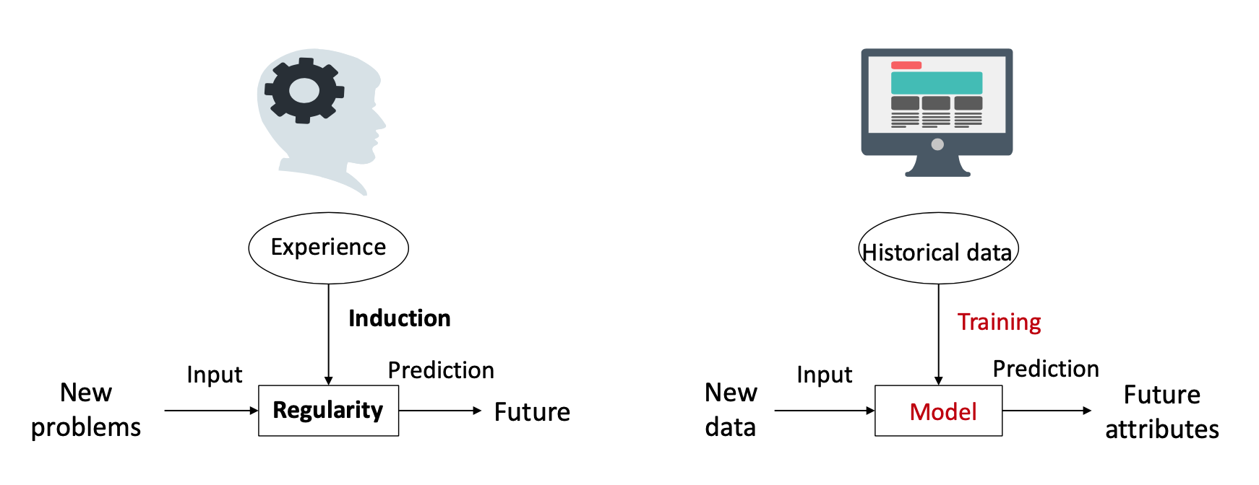
Machine learning algorithms

Slide 5
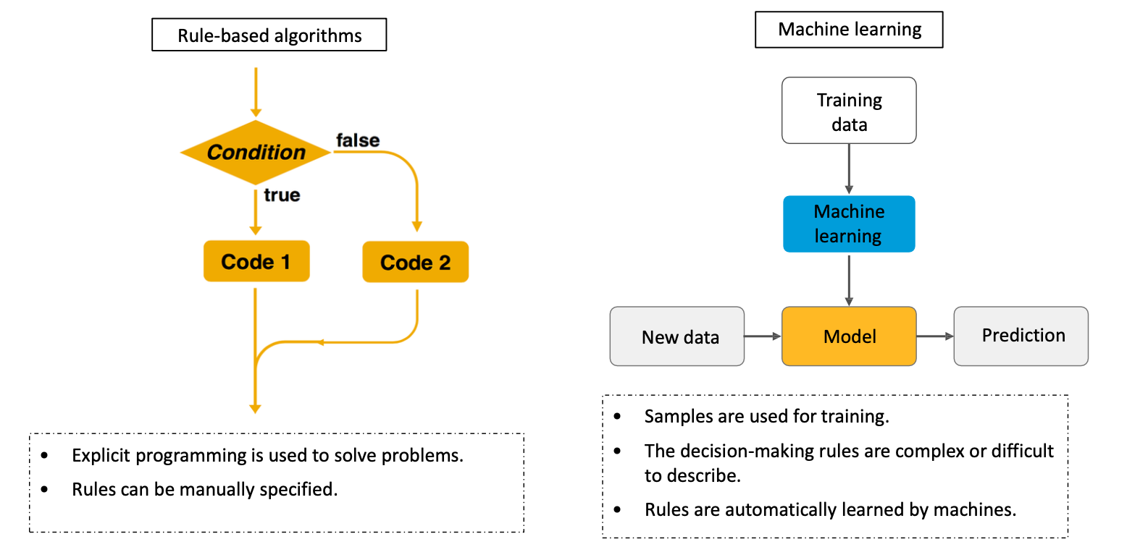
Differences between machine learning algorithms and traditional rule-based algorithms

Slide 6
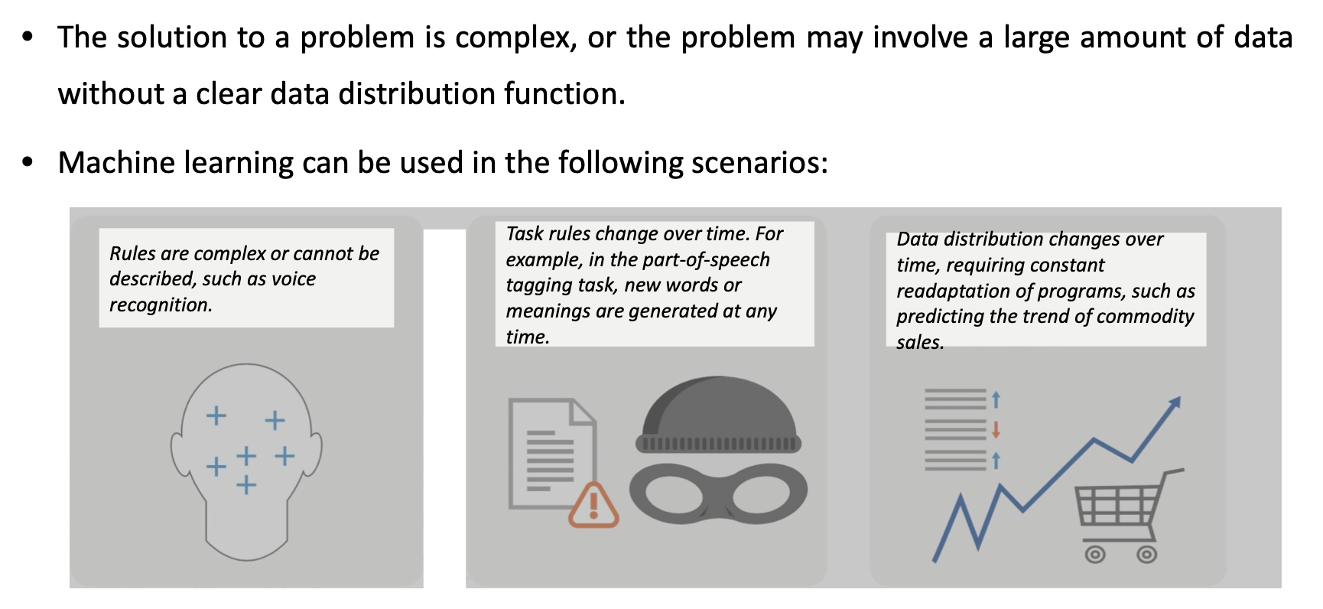
Application scenarios of machine learning

Slide 7
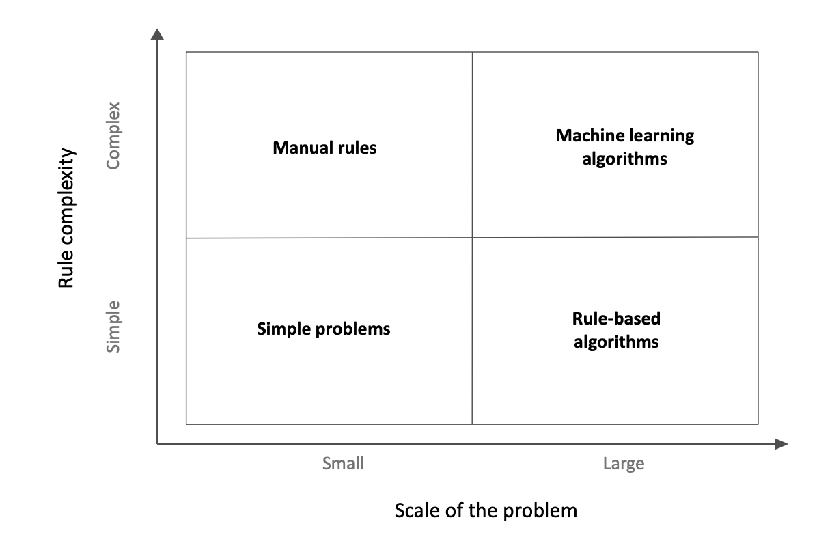
Application scenarios of machine learning

Slide 8
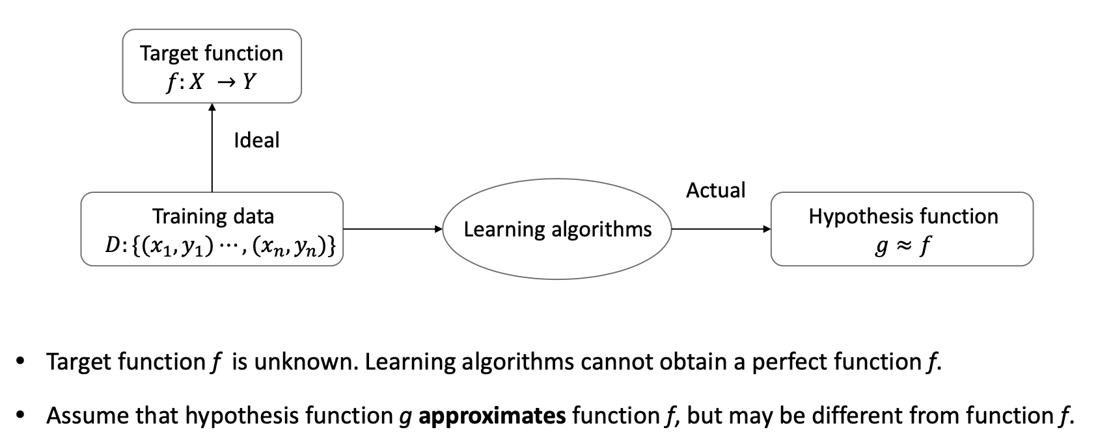
Rational understanding of machine learning algorithms

Slide 9
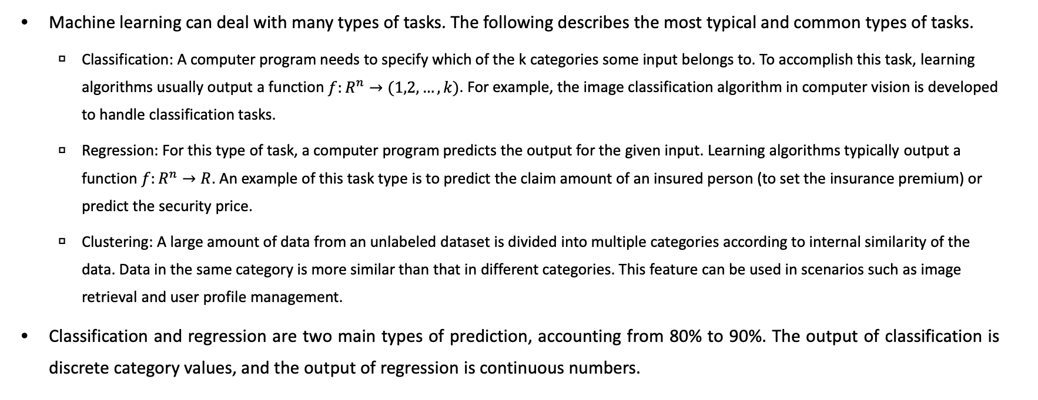
Main problems solved by machine learning

Slide 10
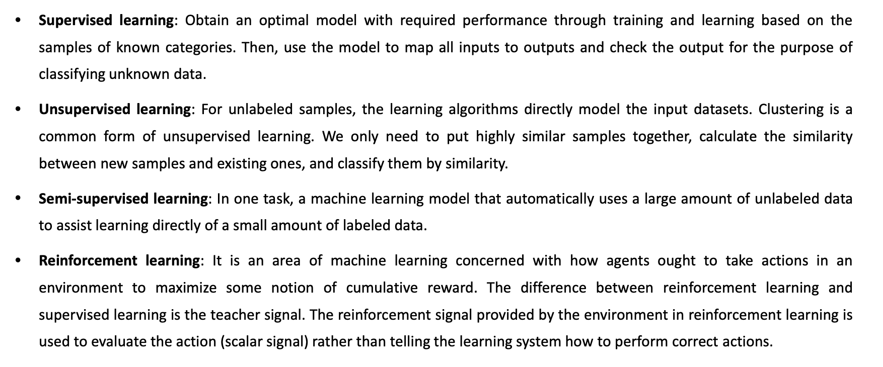
Machine learning classification

Slide 11
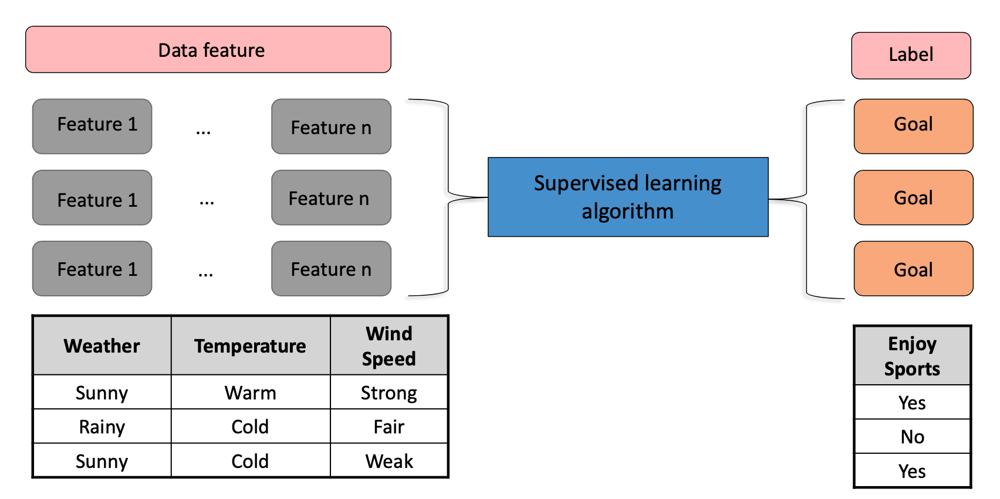
Supervised learning

Slide 12
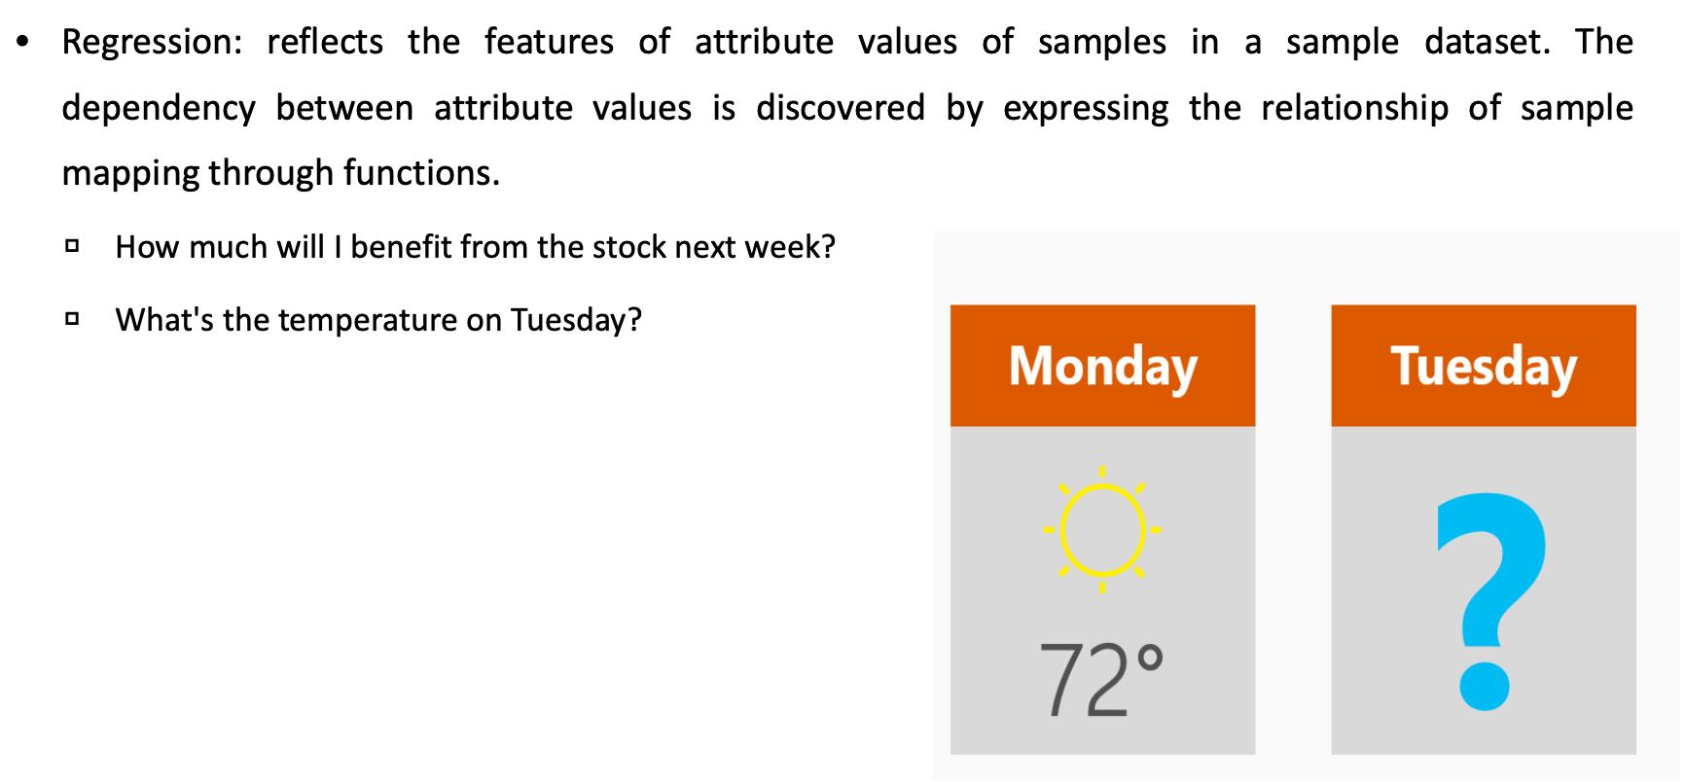
Supervised learning – Regression Questions

Slide 13
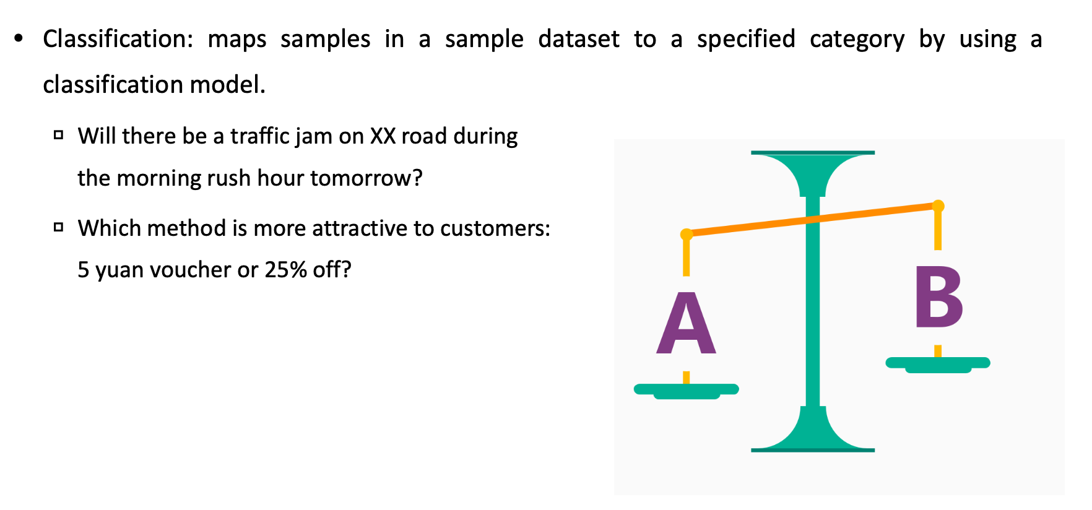
Supervised learning – Classification Questions

Slide 14
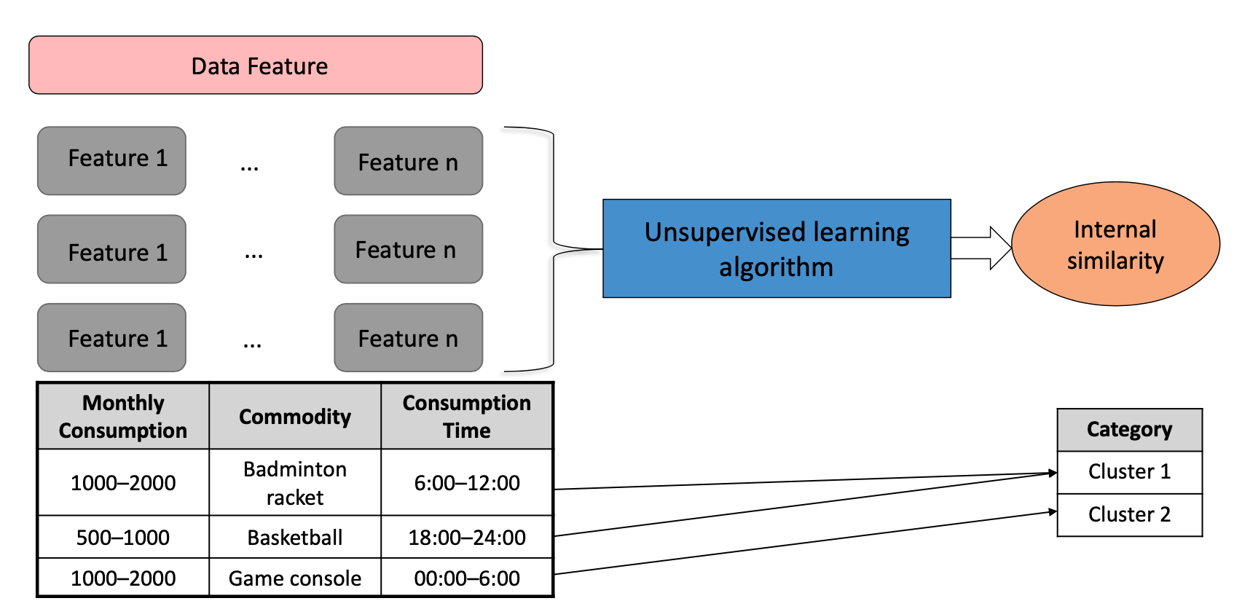
Unsupervised learning

Slide 15
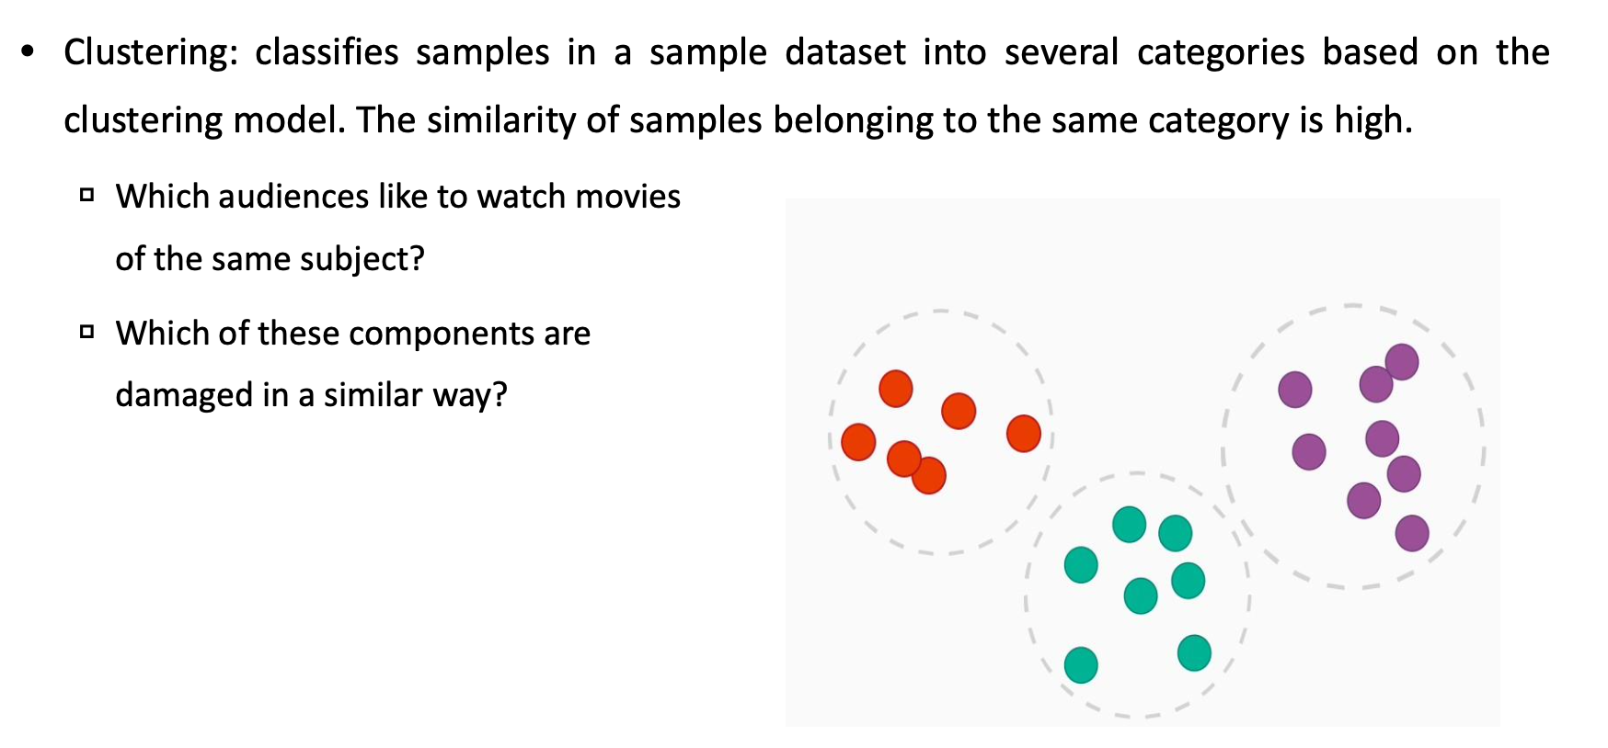
Unsupervised learning – Clustering Questions

Slide 16
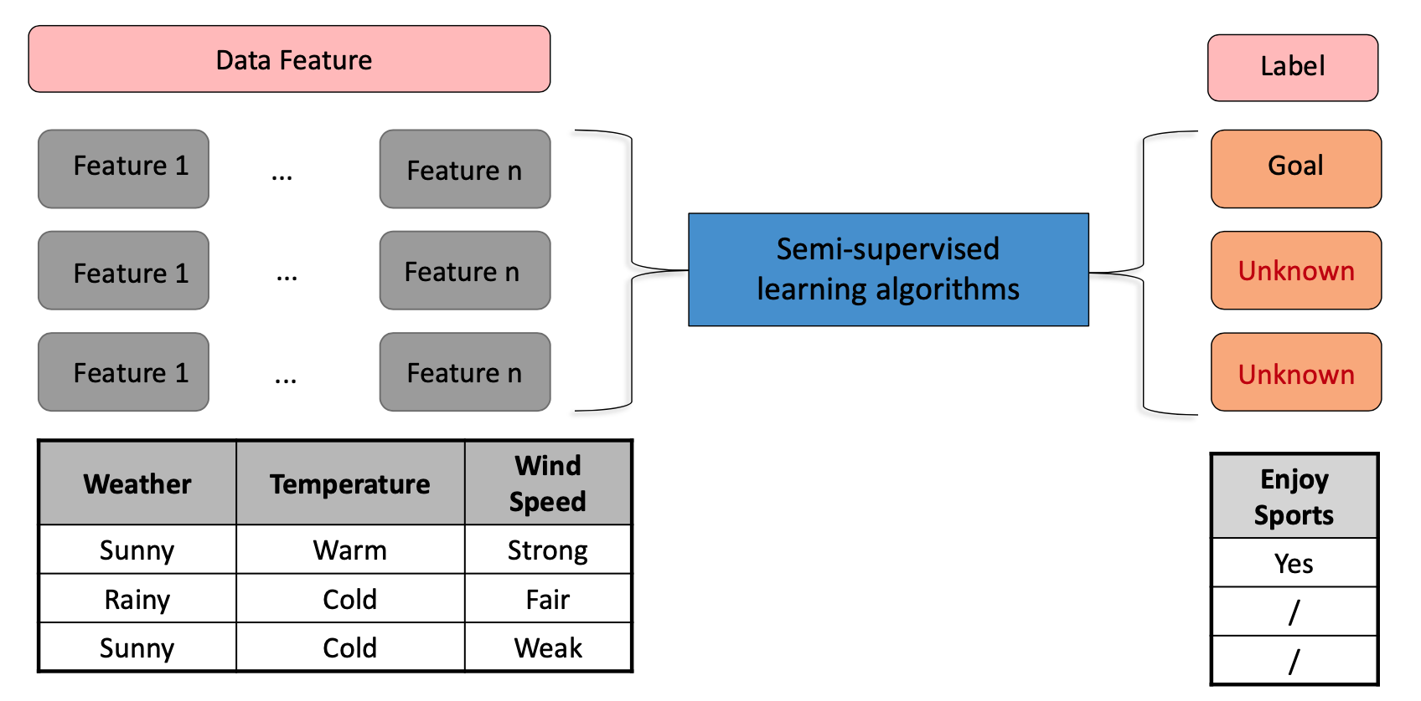
Unsupervised learning – Semi-supervised Learning

Slide 17
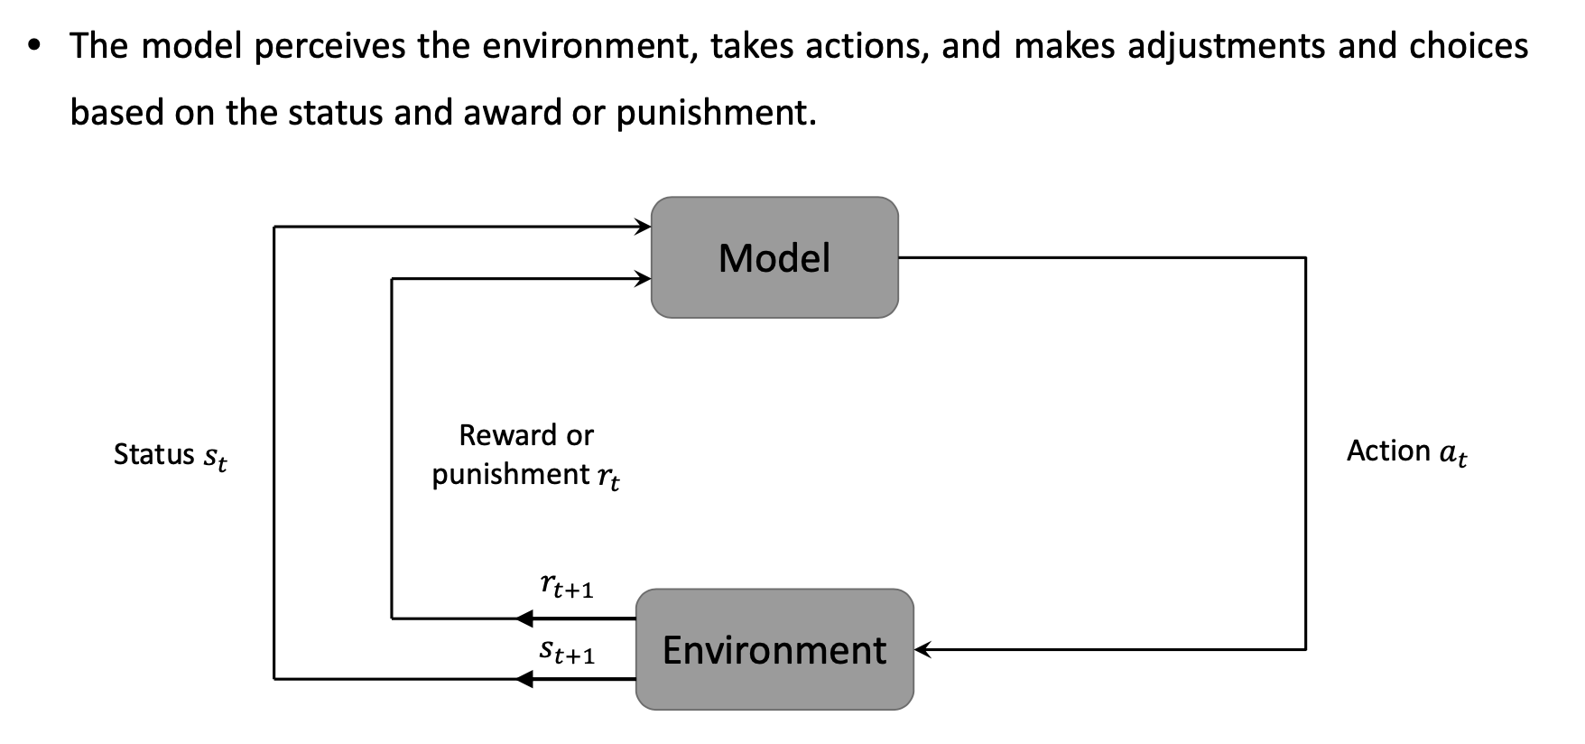
Reinforcement Learning

Slide 18
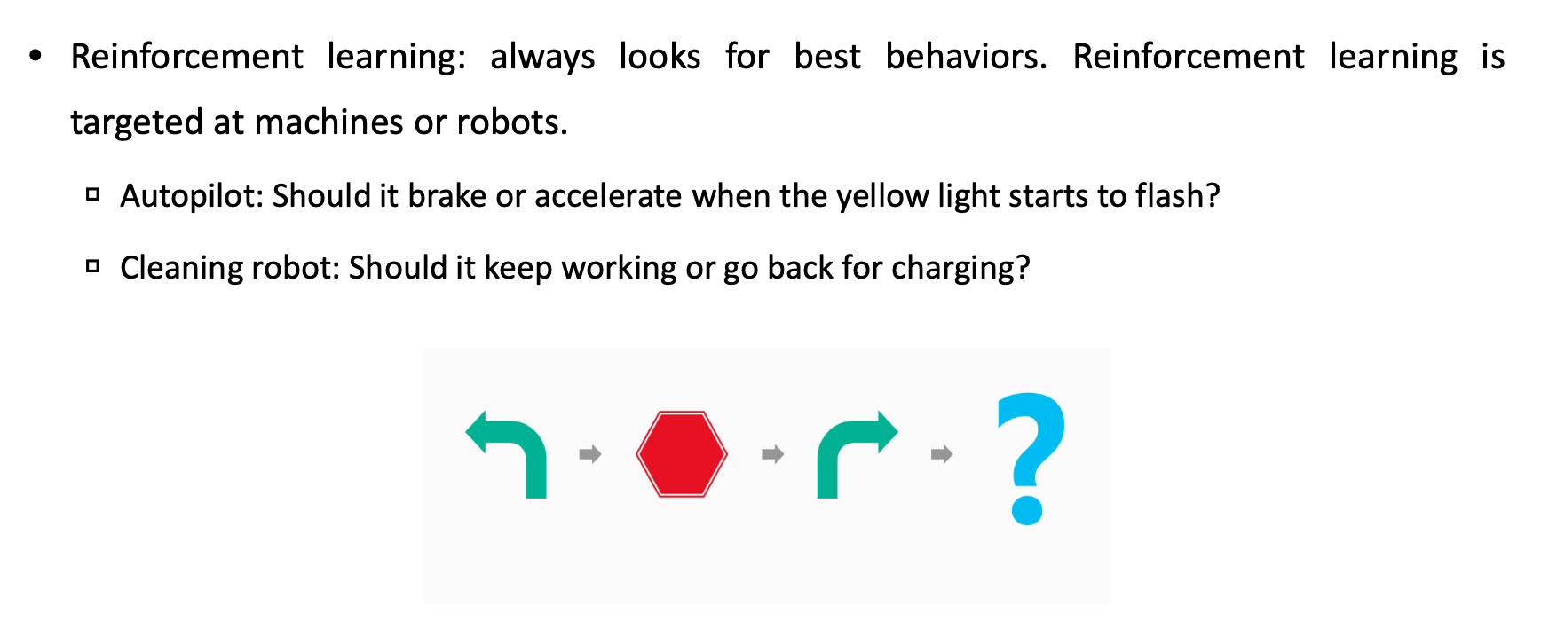
Reinforcement Learning – Best behavior

Slide 19
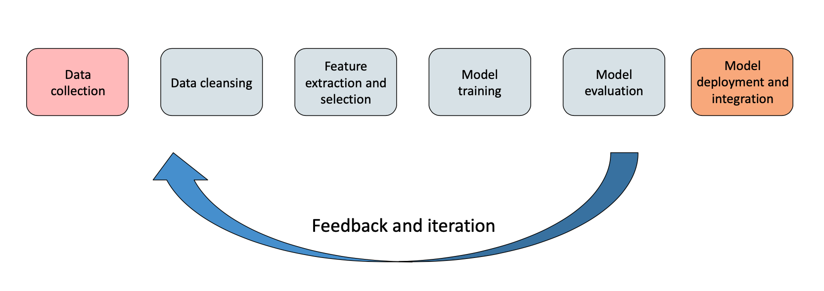
Machine learning process

Slide 20
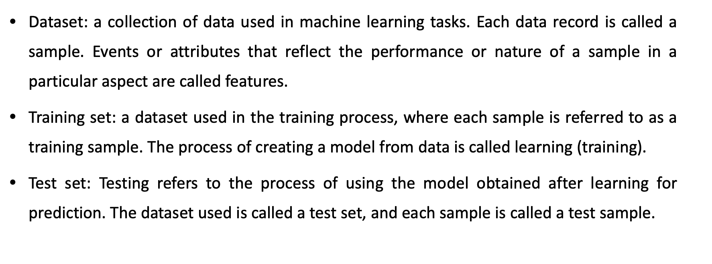
Basic Machine Learning Concept - Dataset

Slide 21
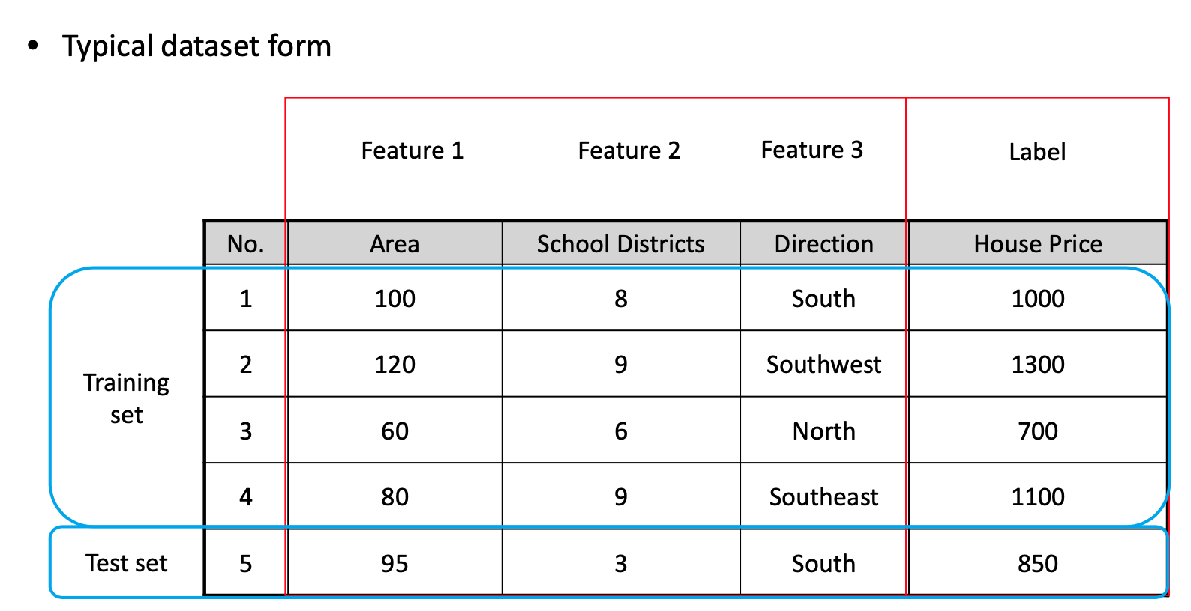
Checking Data Overview

Slide 22
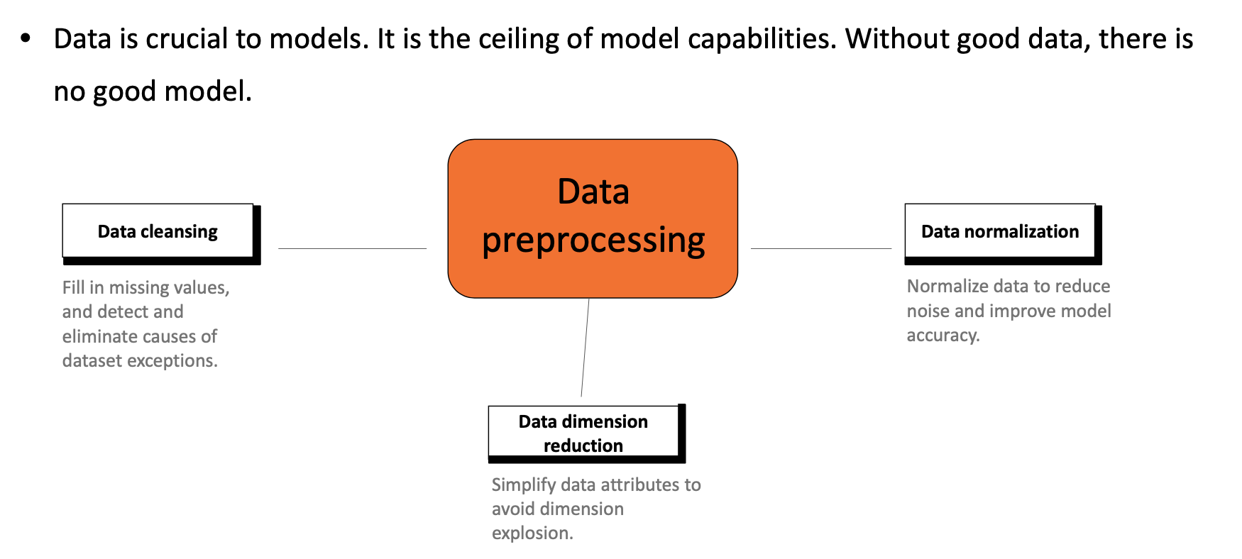
Importance of Data Processing

Slide 23
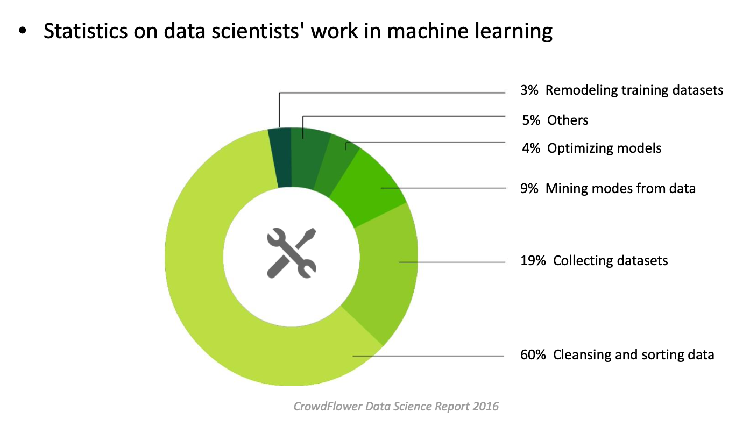
Workload of Data Cleansing

Slide 24
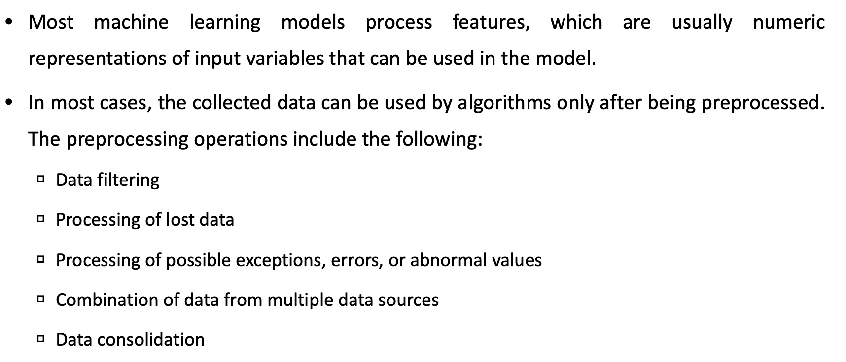
Data Cleansing

Slide 25
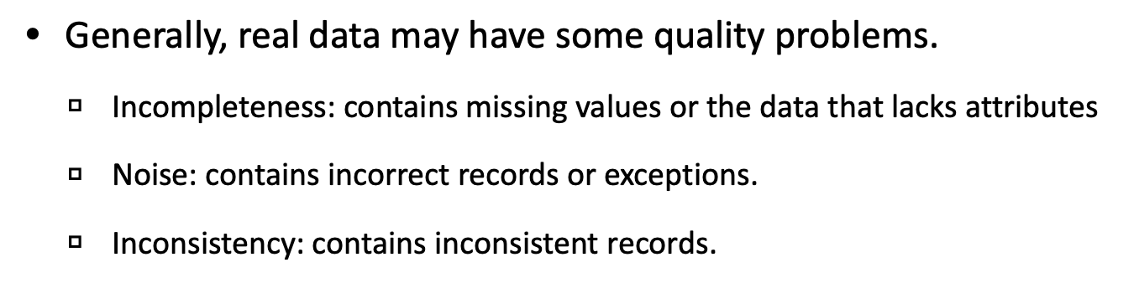
Dirty Data

Slide 26
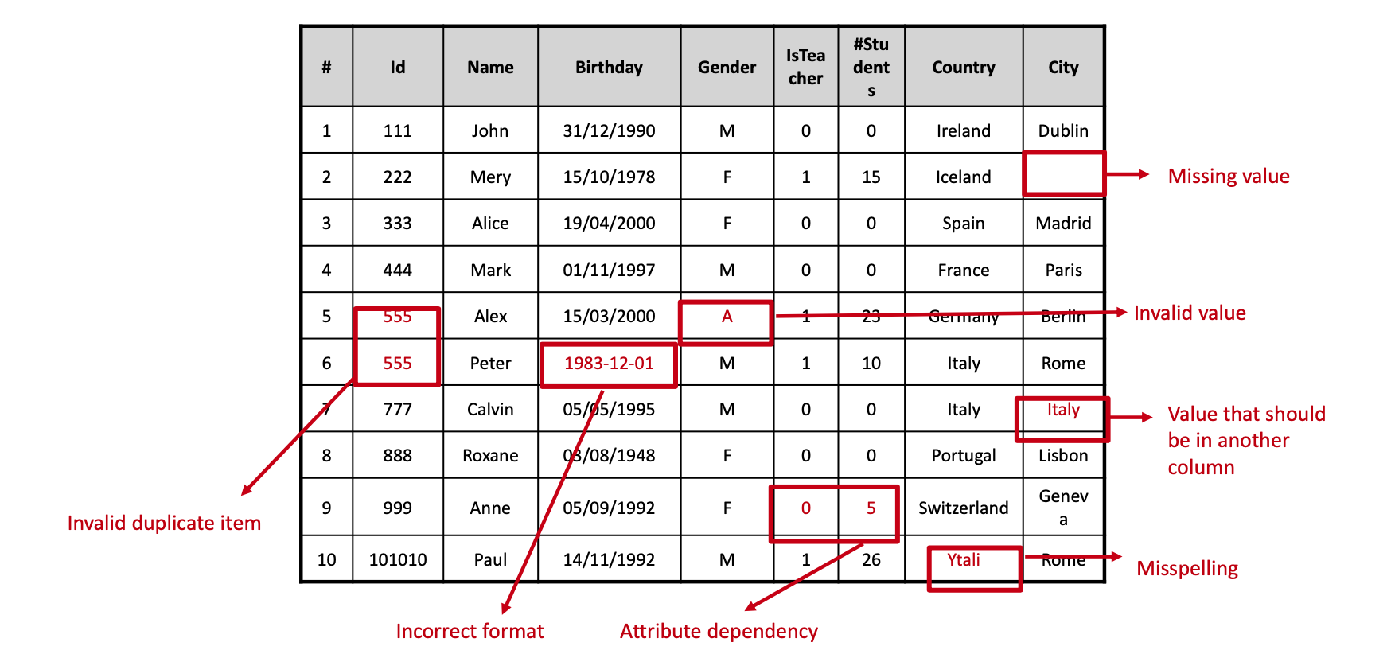
Dirty Data (continue)

Slide 27
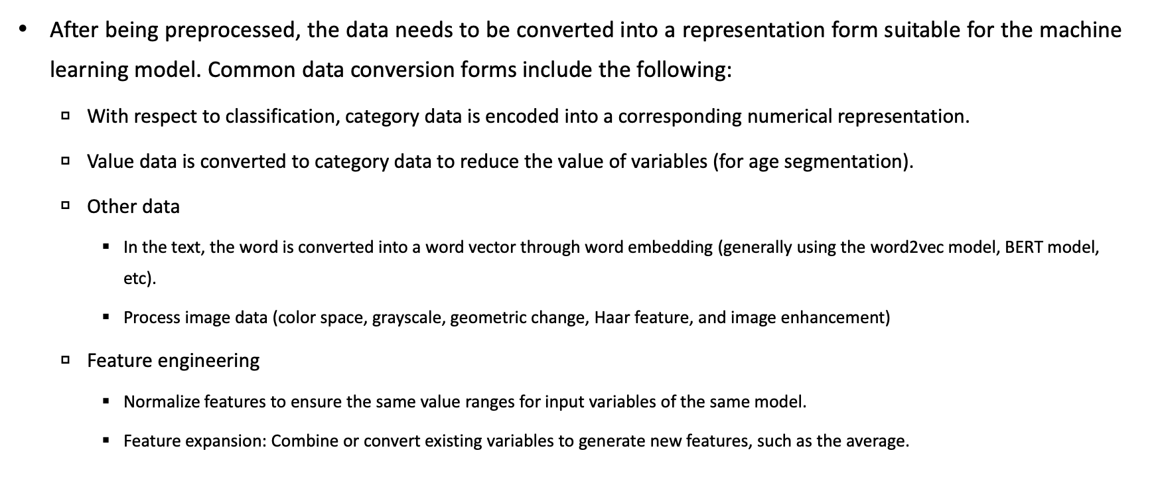
Data Conversion

Slide 28
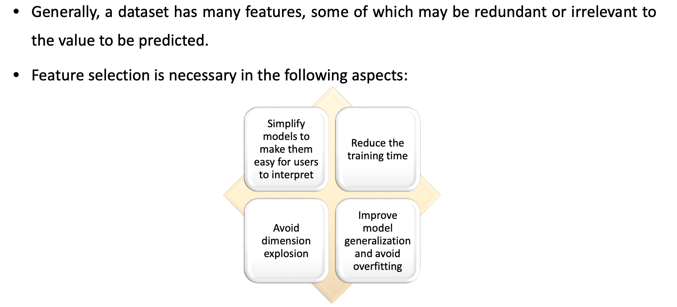
Necessity of Feature Selection

Slide 29
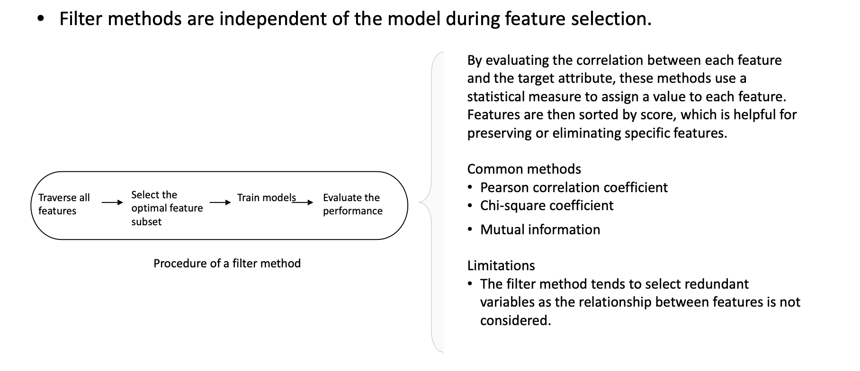
Feature Selection Methods: Filter

Slide 30
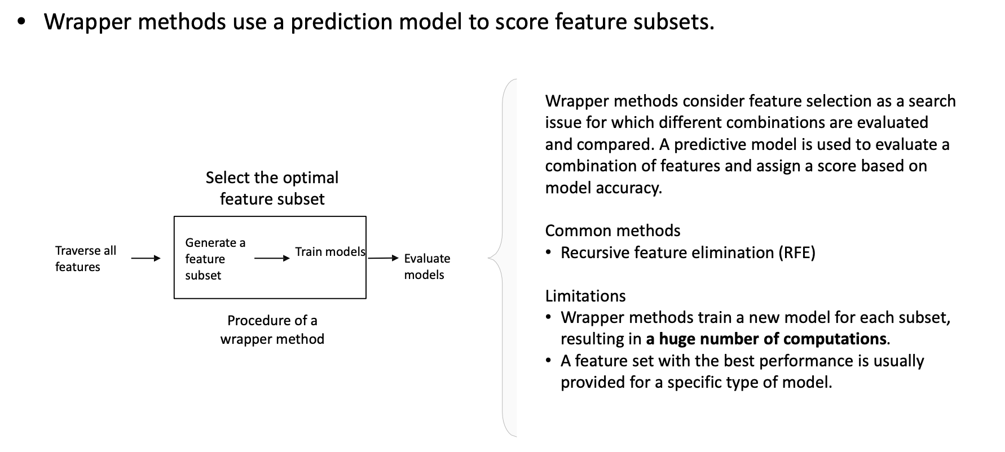
Feature Selection Methods: Wrapper

Slide 31
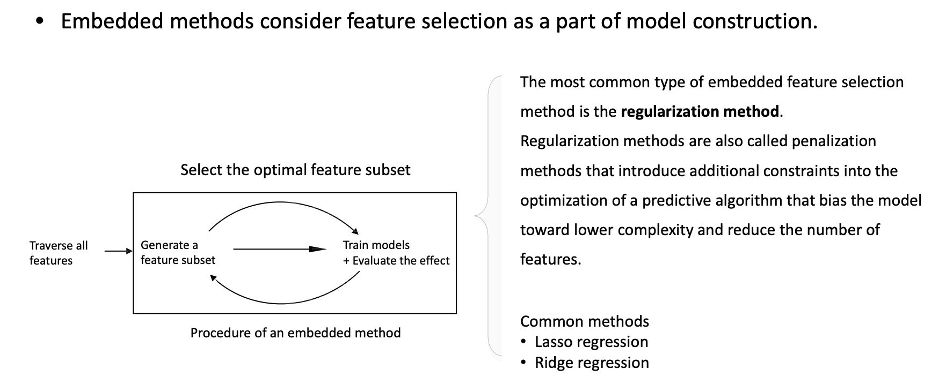
Feature Selection Methods: Embedded

Slide 32
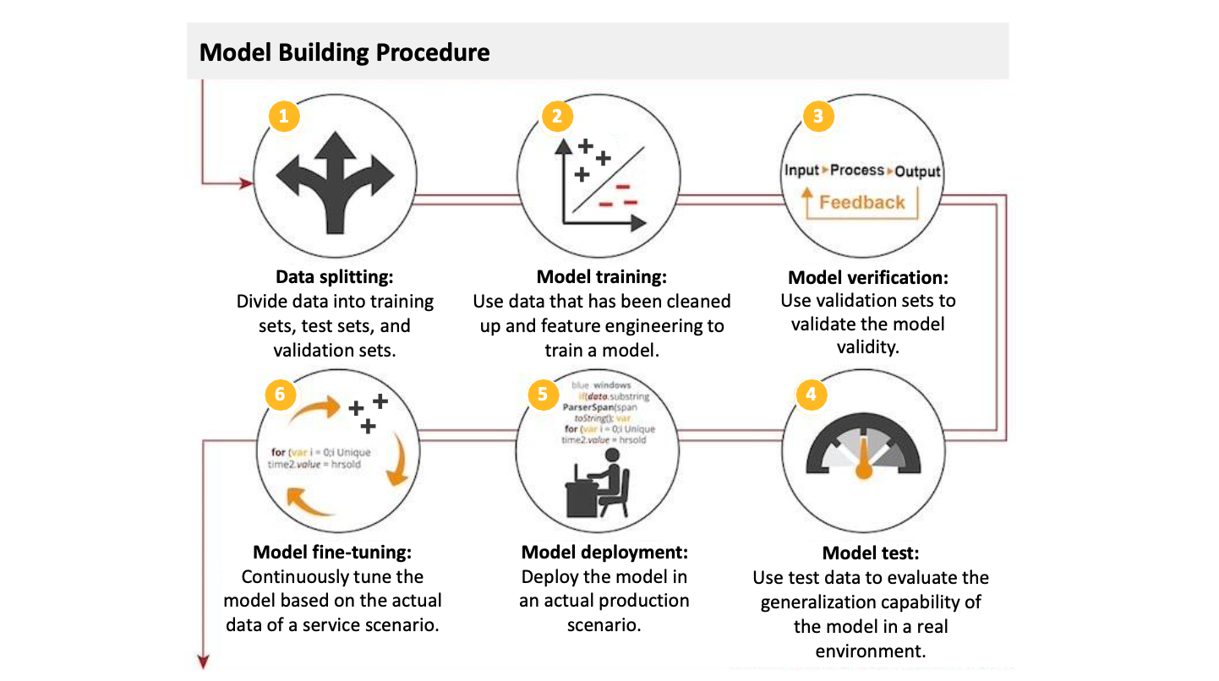
Overall Procedure of Building a Model

Slide 33
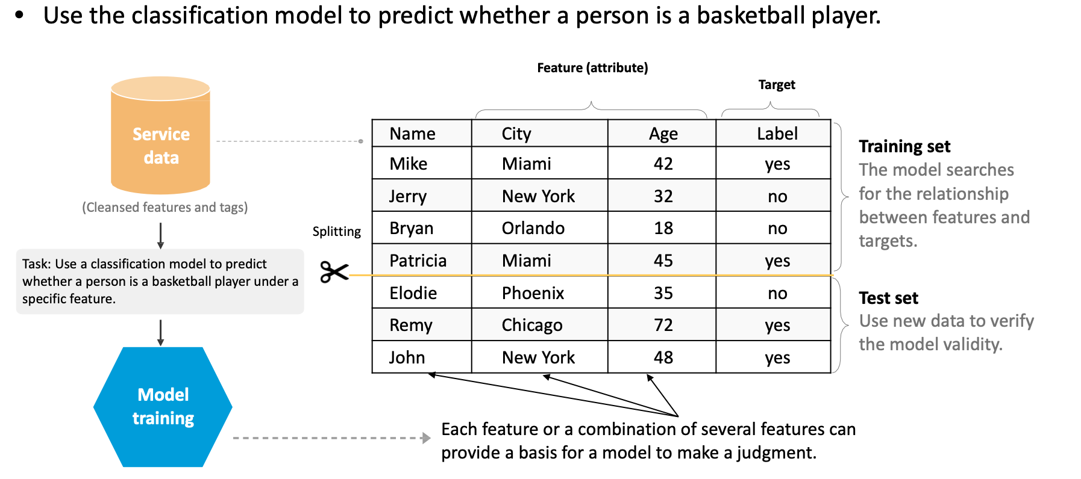
Examples of Supervised Learning: Learning Phase

Slide 34
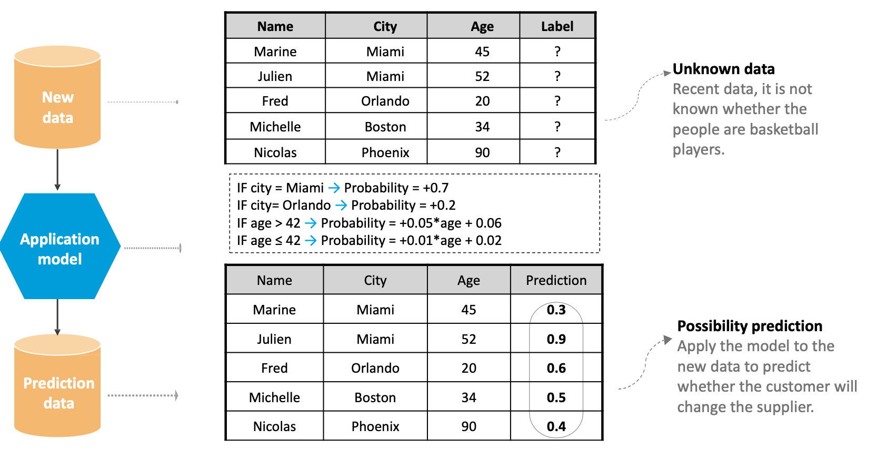
Examples of Supervised Learning: Prediction Phase

Slide 35
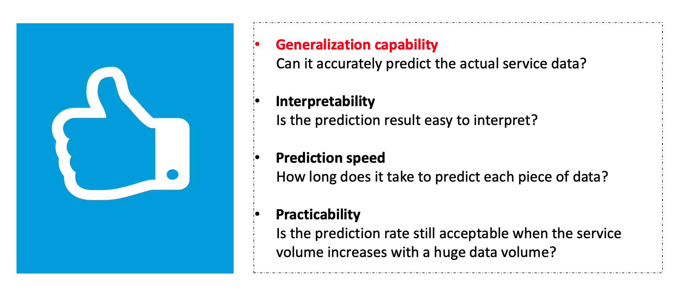
What is a Good Model?

Slide 36
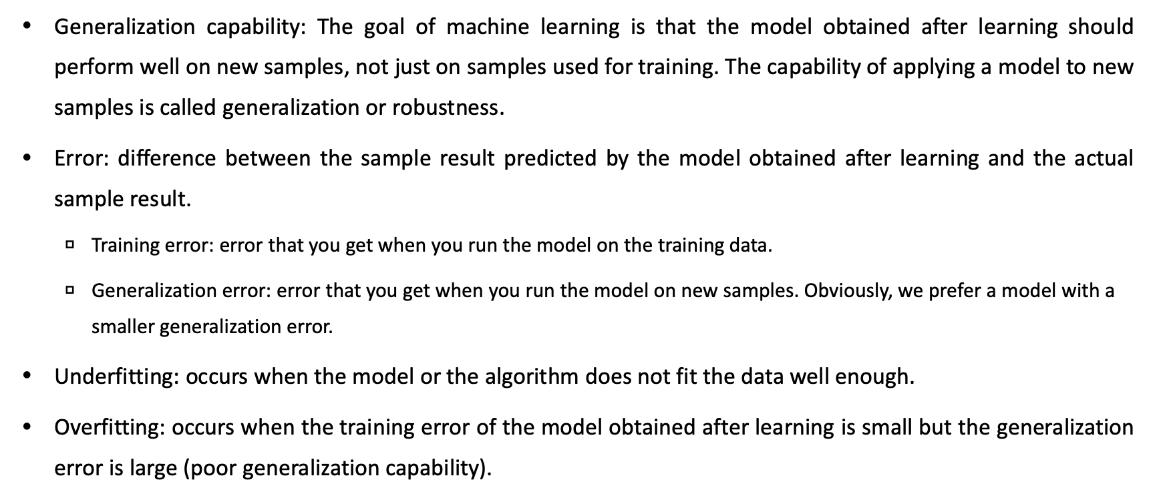
Model Validity

Slide 37
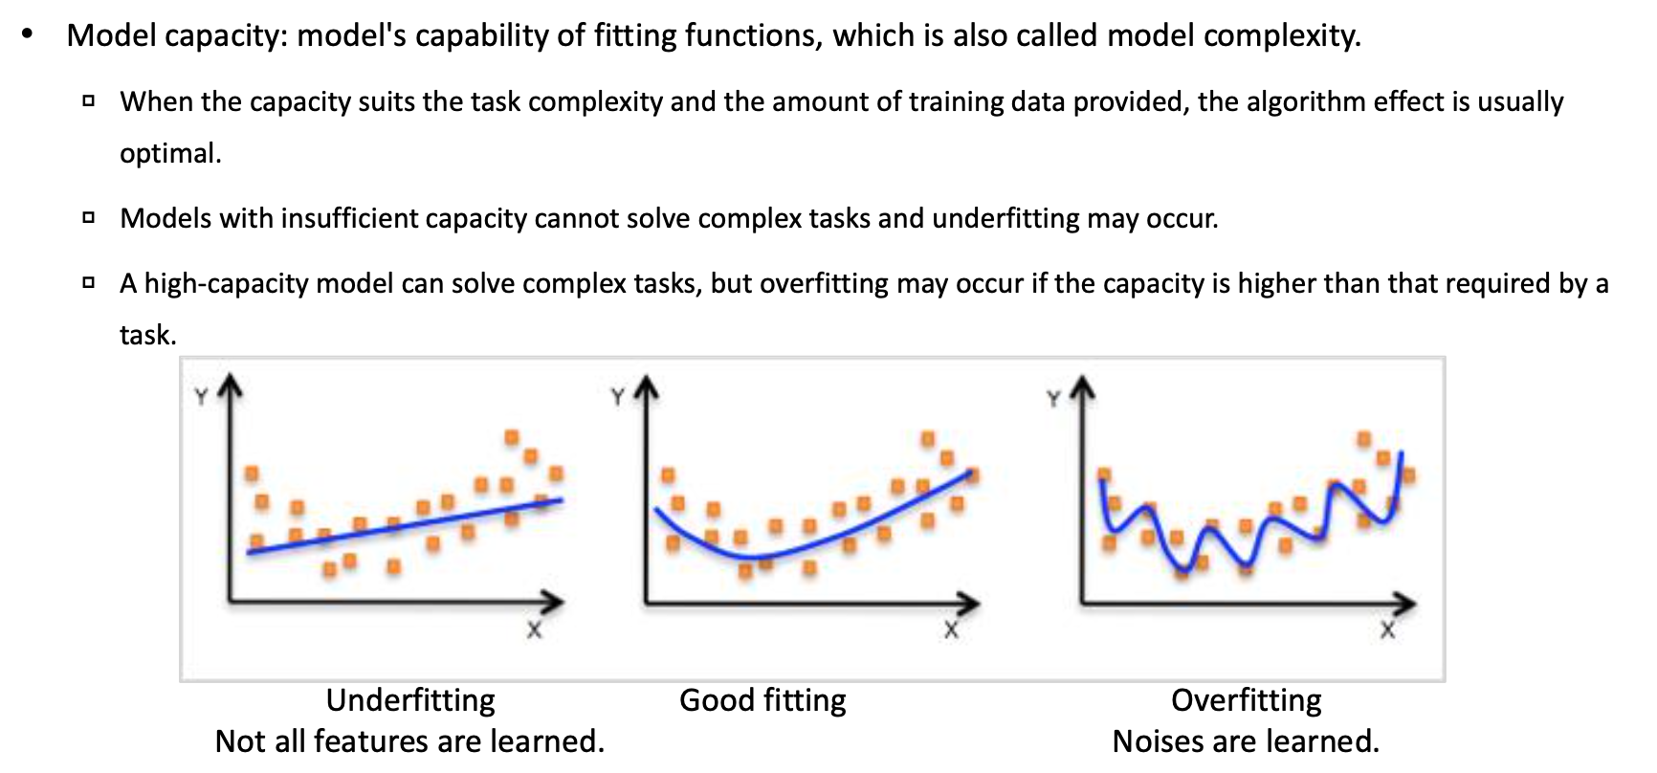
Model Validity (continue)

Slide 38
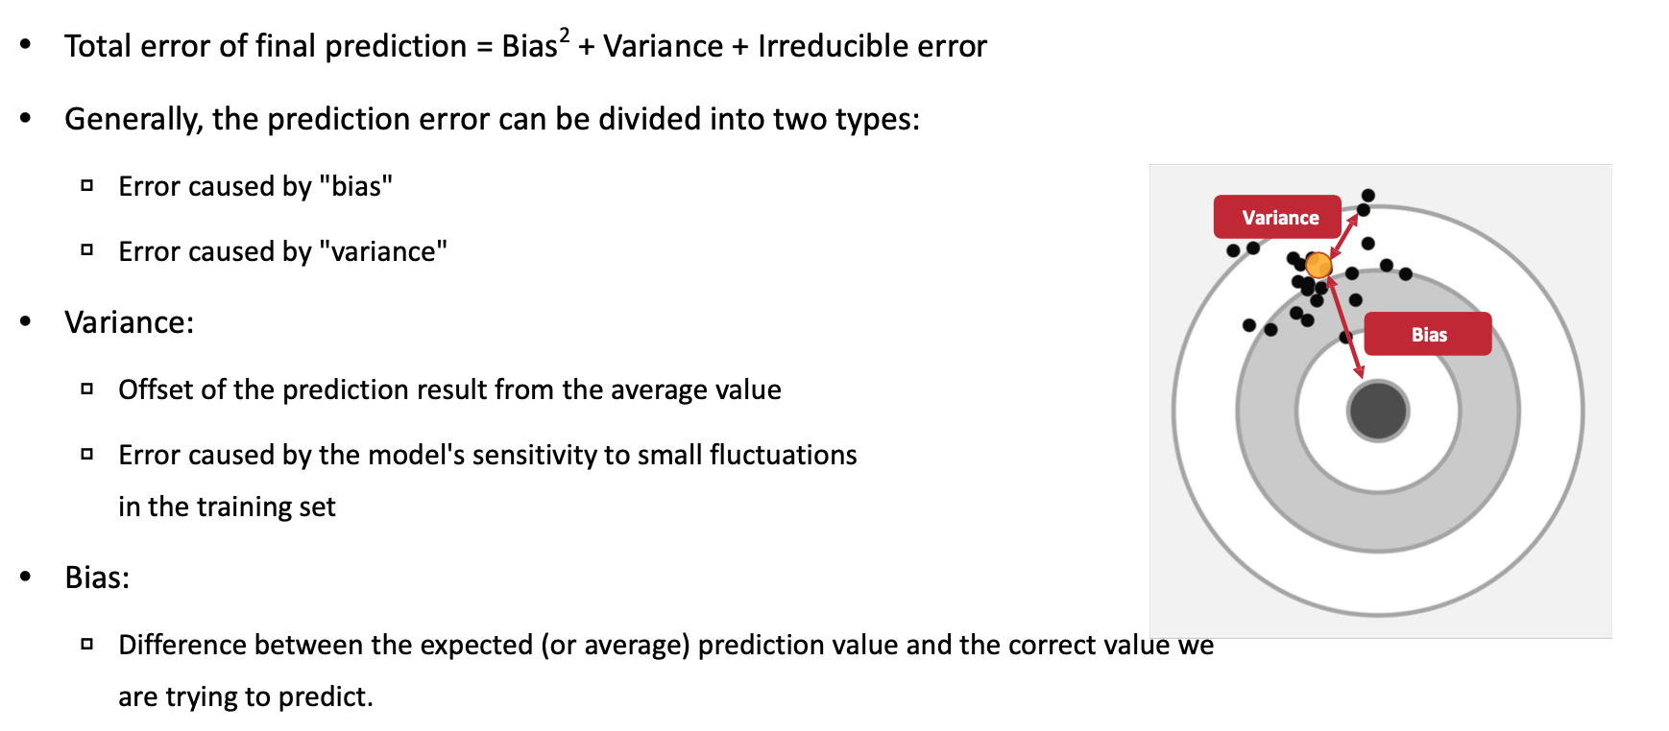
Overfitting Cause: Error

Slide 39
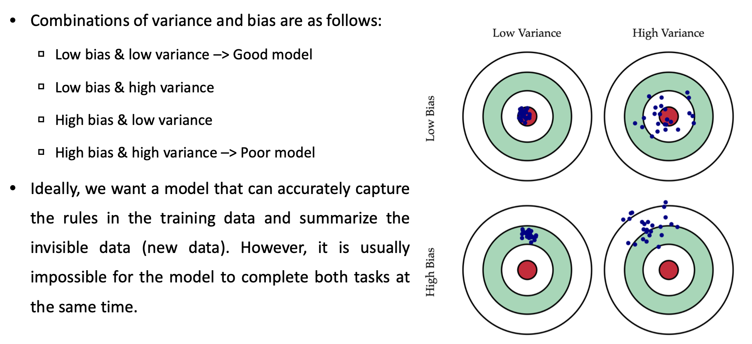
Variance and Bias

Slide 40
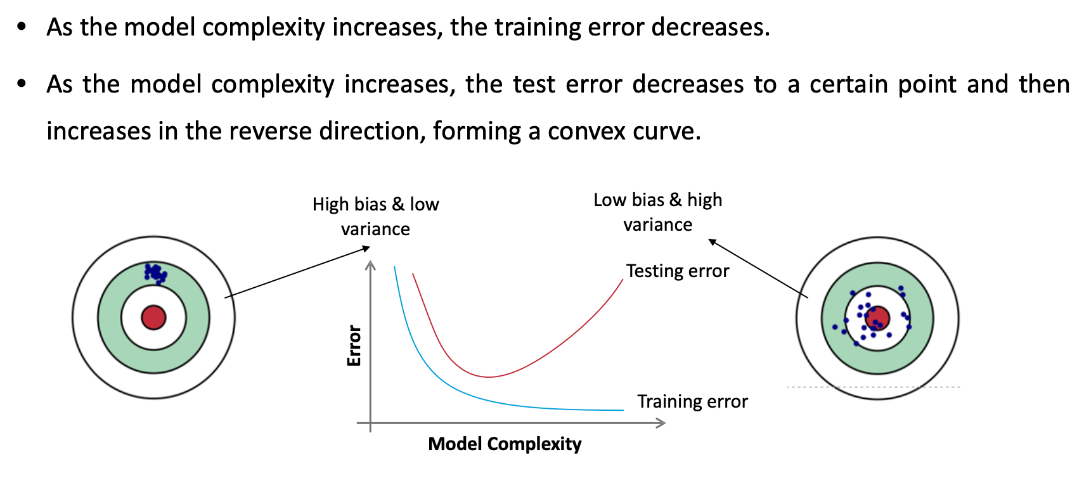
Model Complexity and Error

Slide 41
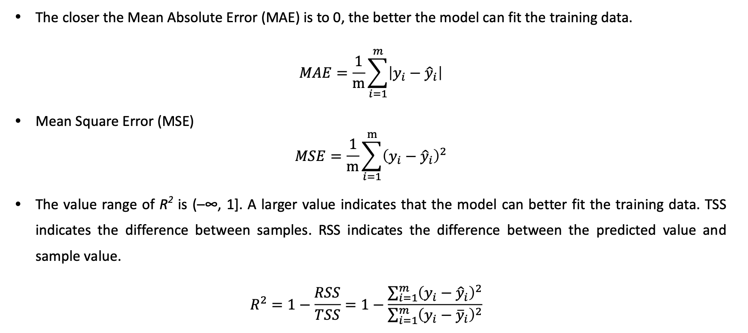
Machine Learning Performance Evaluation: Regression

Slide 42
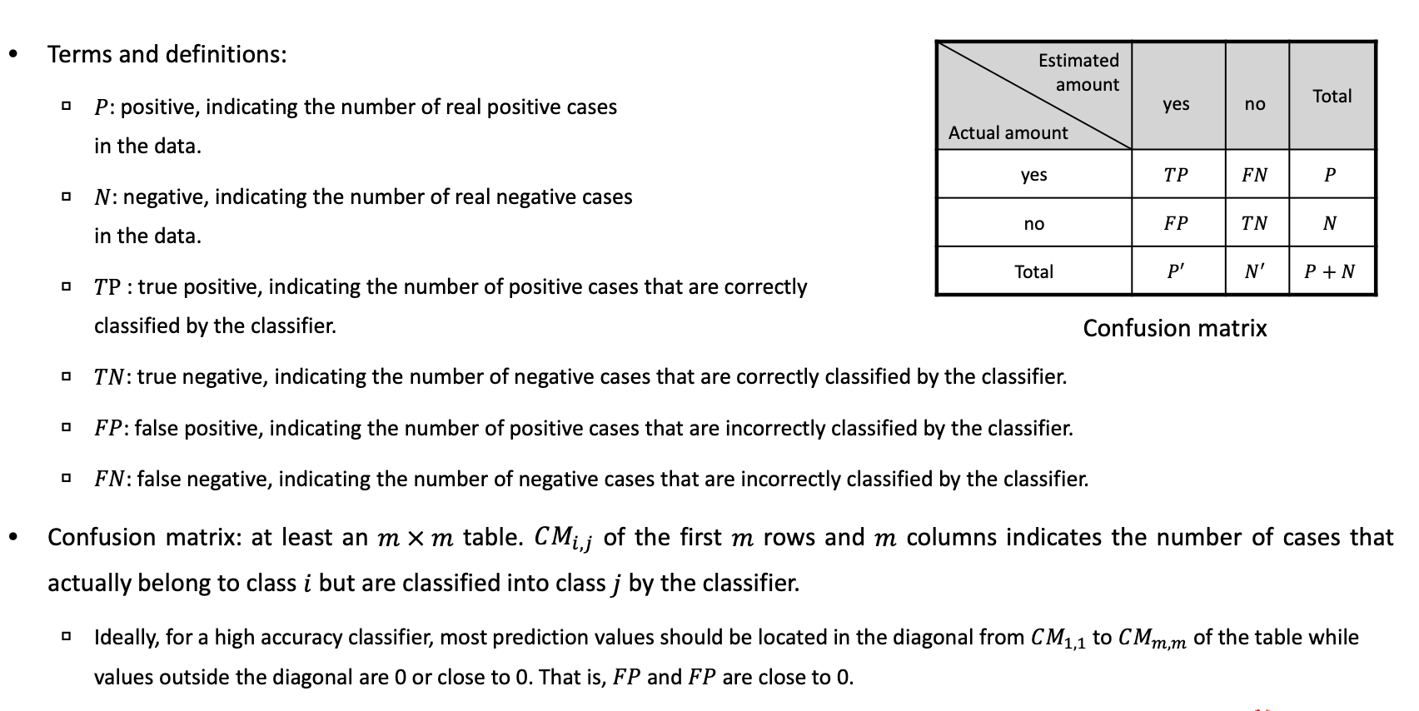
Machine Learning Performance Evaluation: Classification (1)

Slide 43
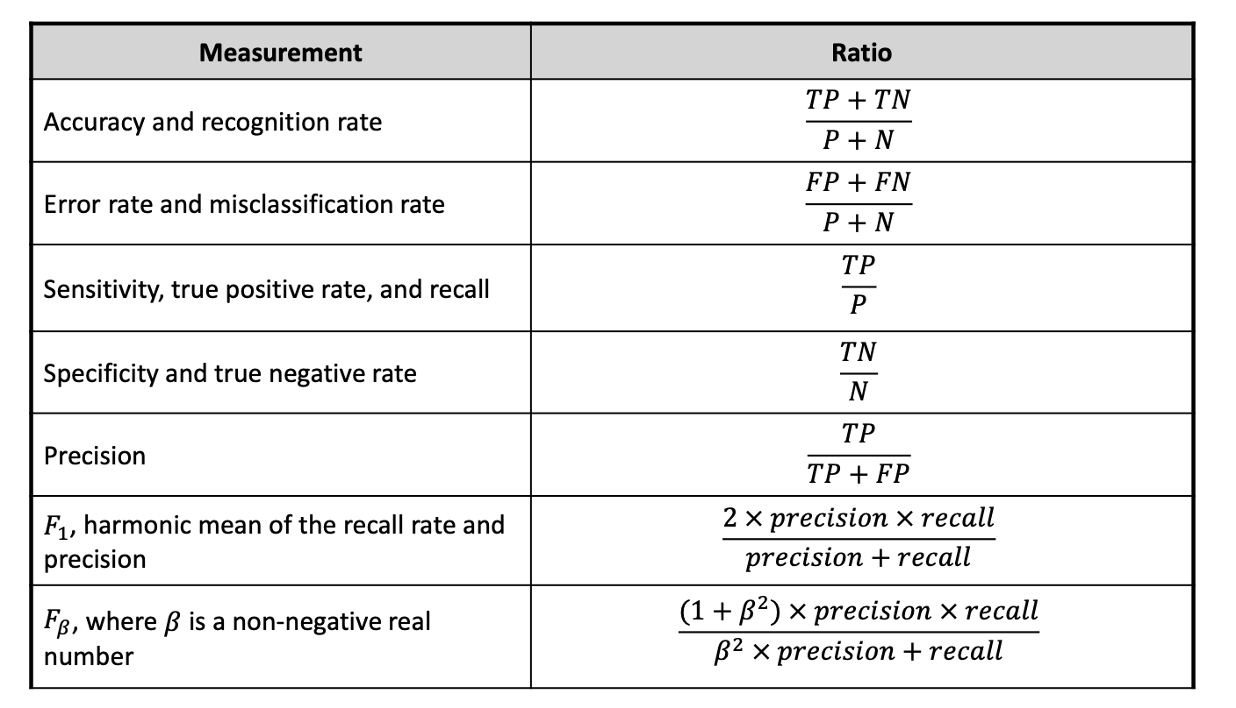
Machine Learning Performance Evaluation: Classification (2)

Slide 44
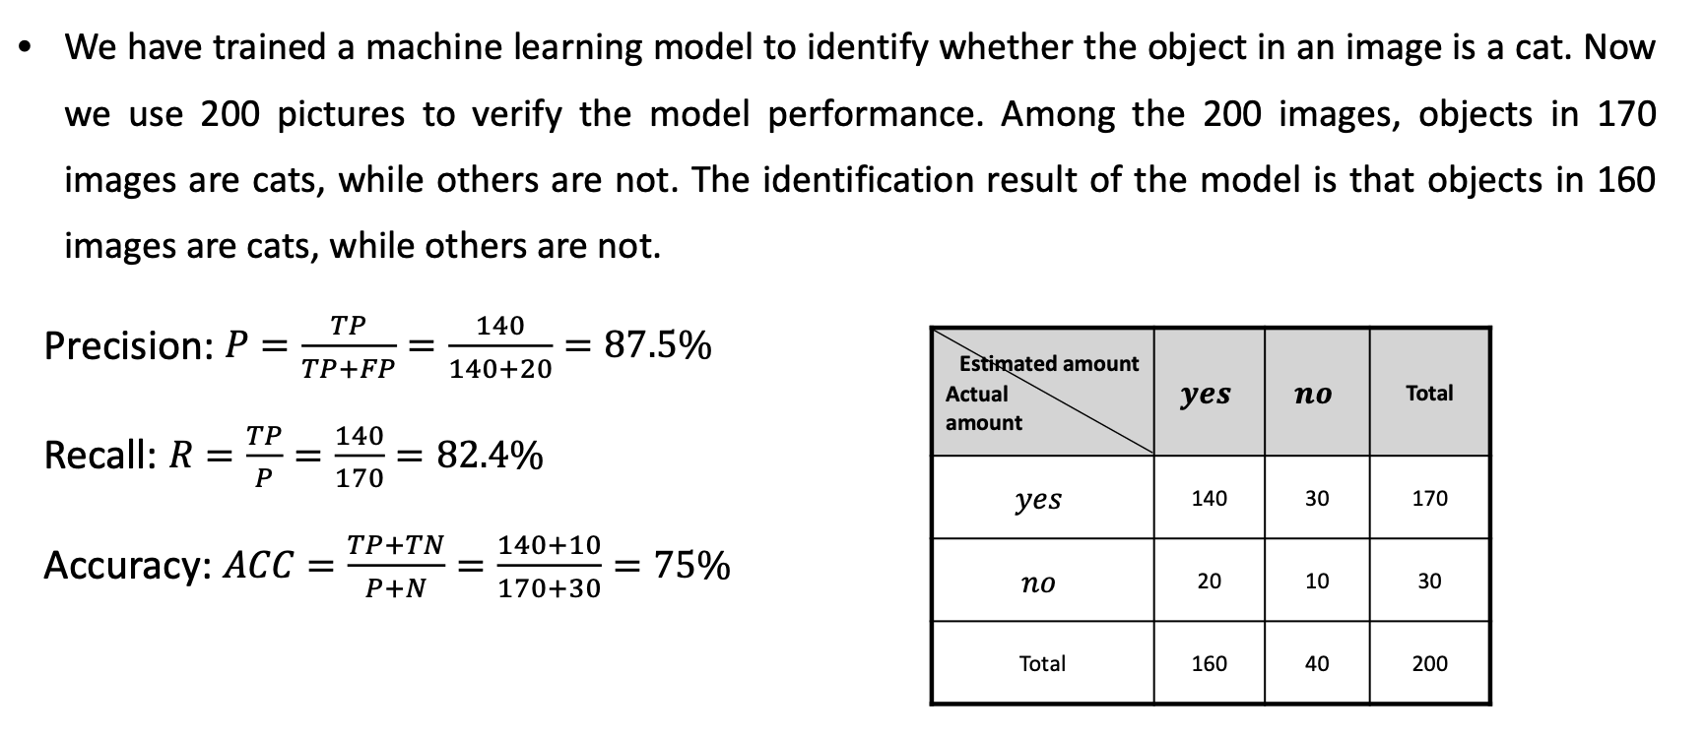
Example of Machine Learning Performance Evaluation

Slide 45
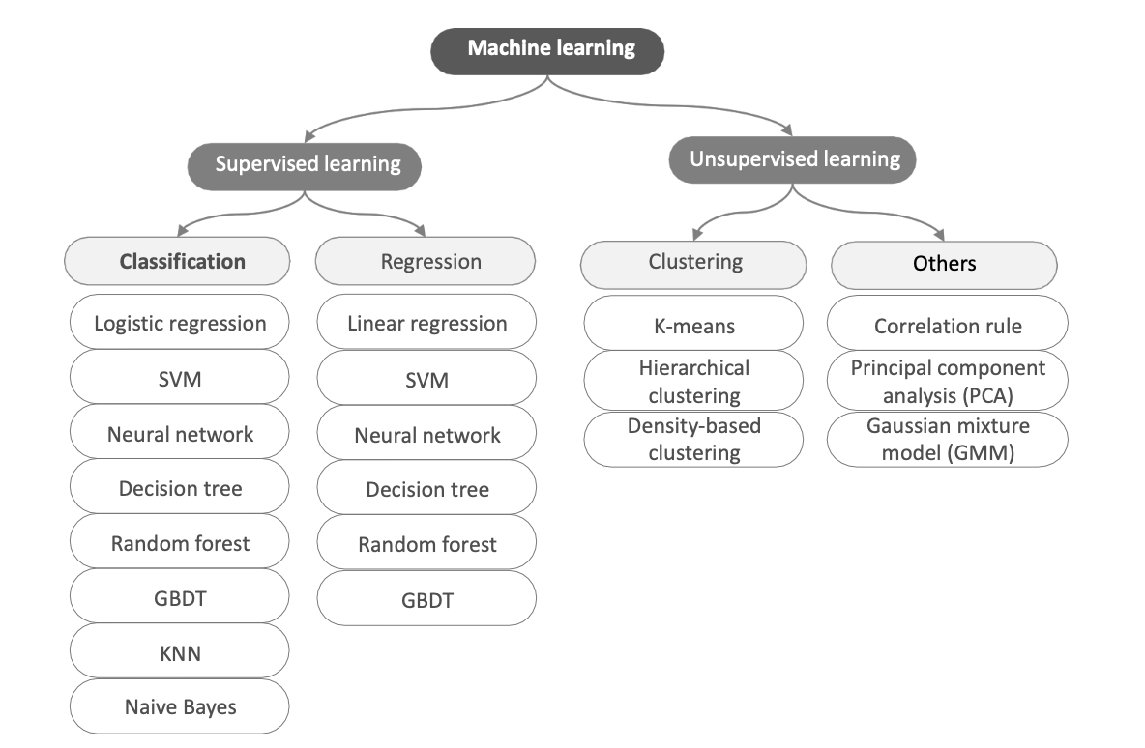
Machine Learning Algorithm Overview

Slide 46
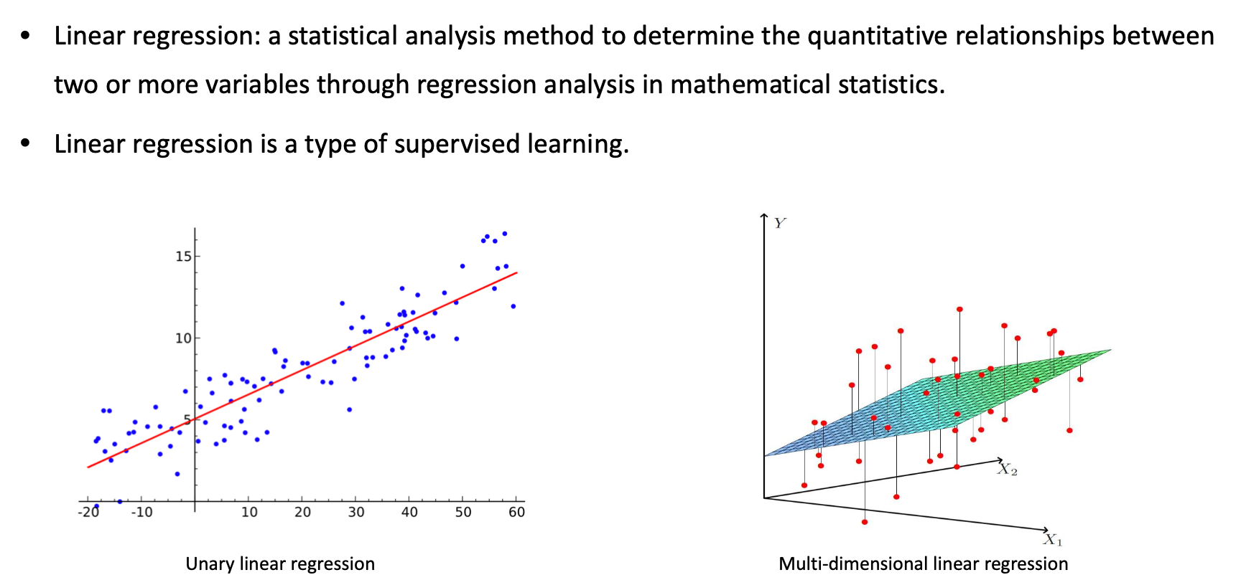
Linear Regression

Slide 47
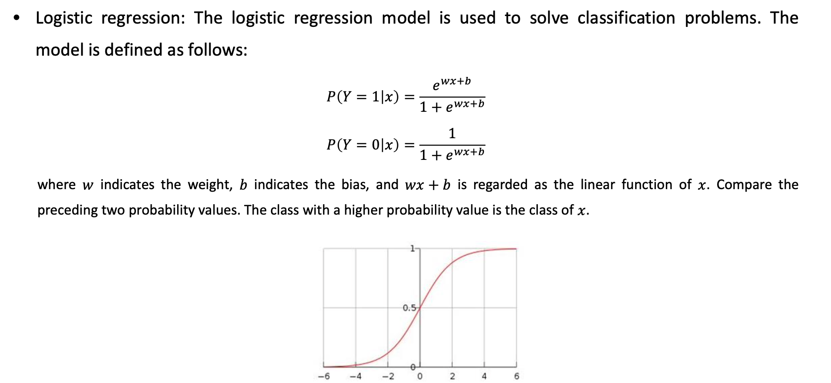
Logistic Regression

Slide 48
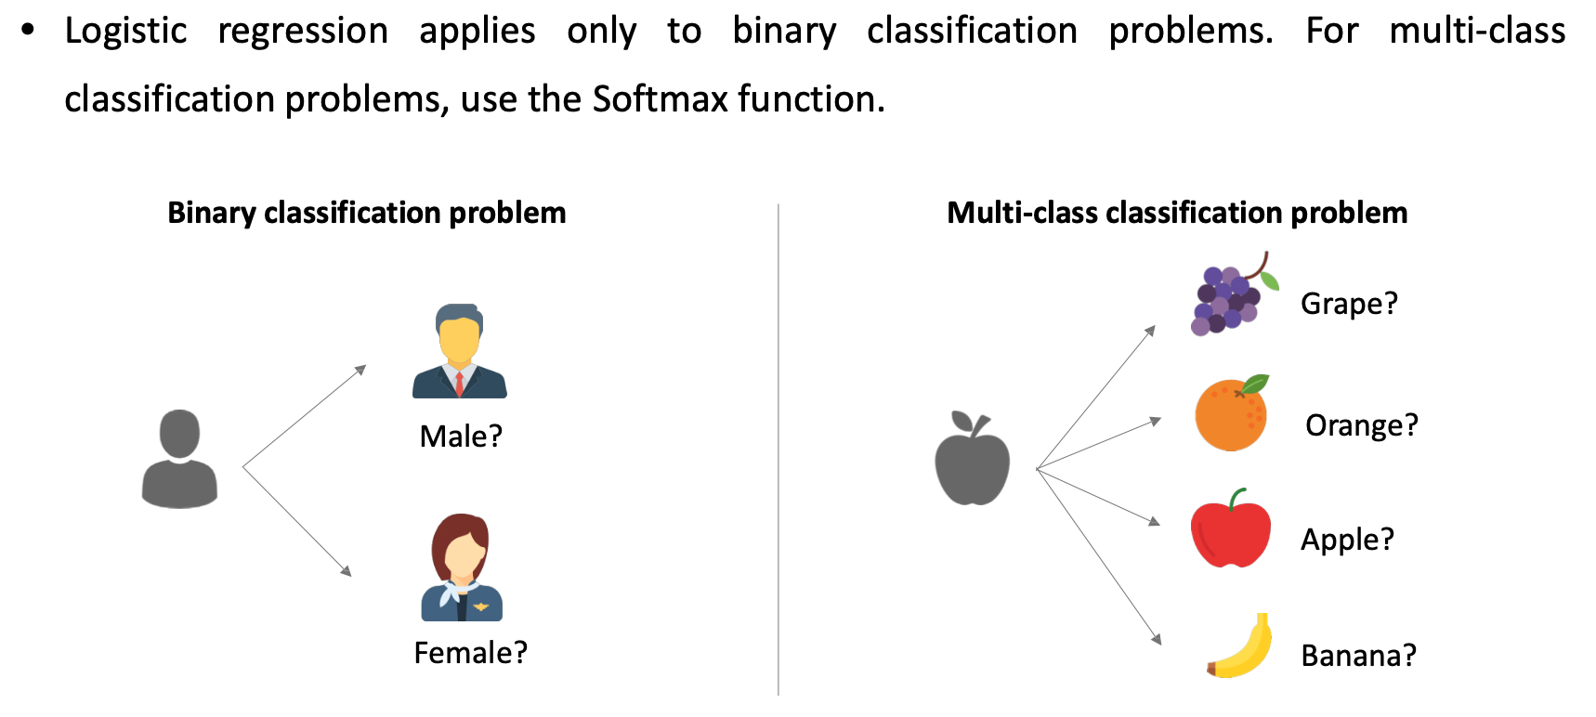
Logistic Regression Extension: Softmax Function (1)

Slide 49
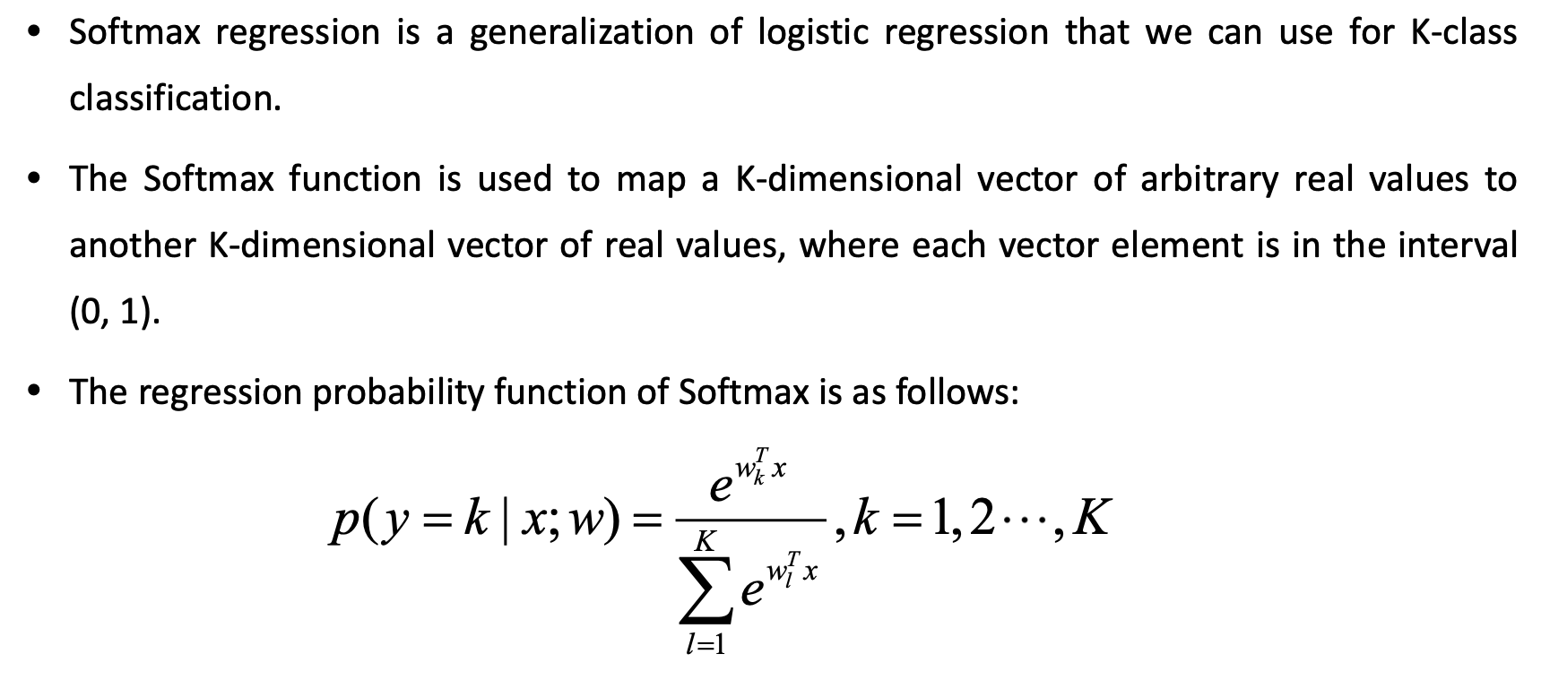
Logistic Regression Extension: Softmax Function (2)

Slide 50
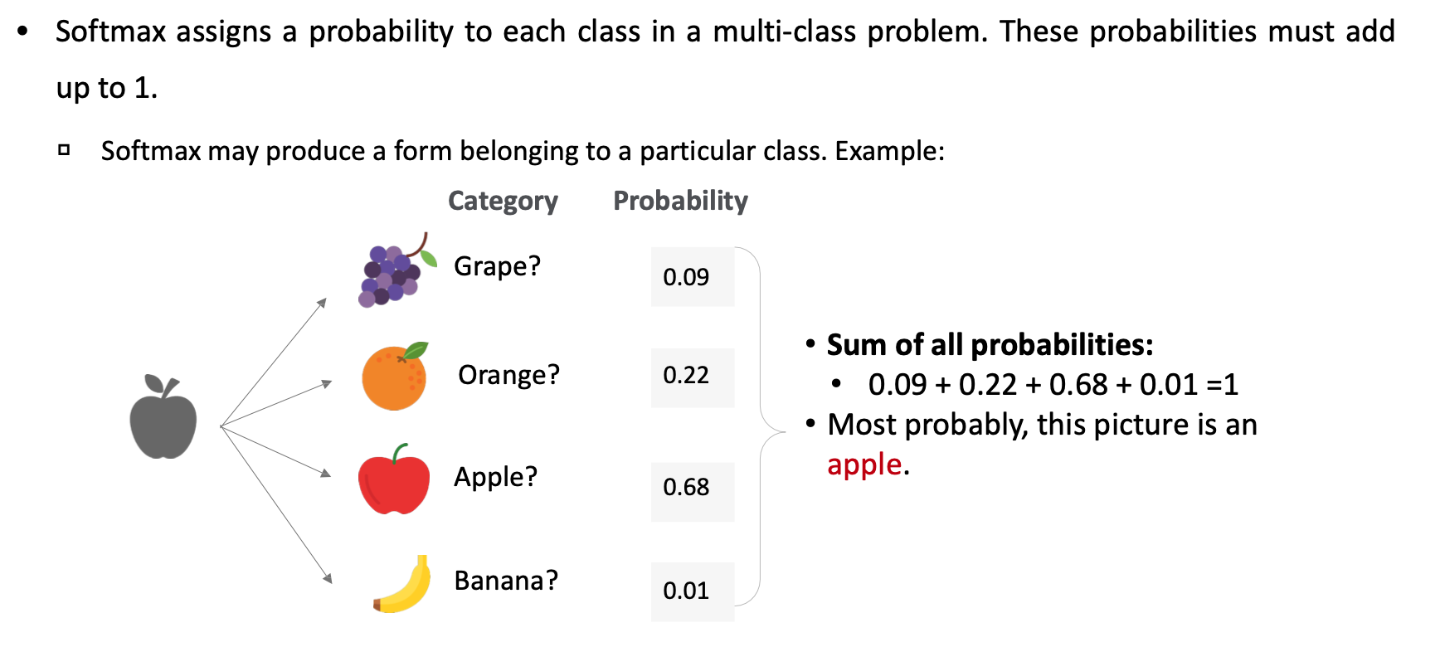
Logistic Regression Extension: Softmax Function (3)

Slide 51
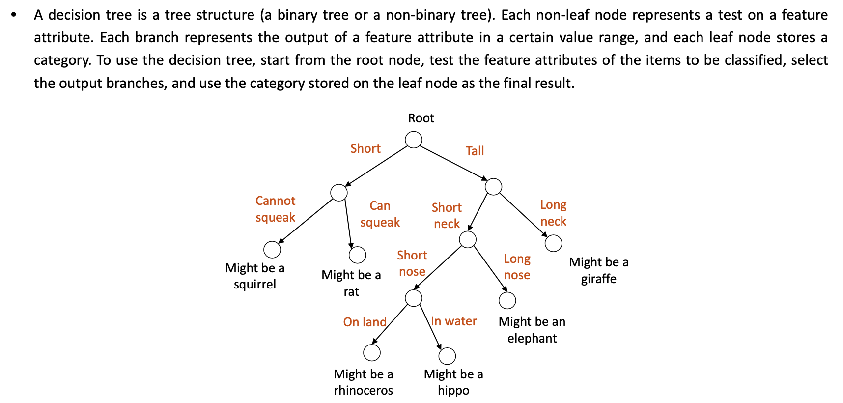
Decision Tree

Slide 52
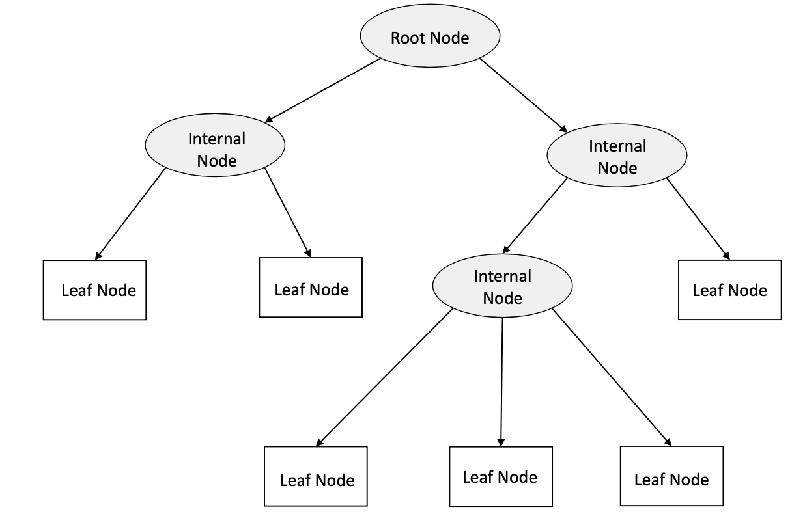
Decision Tree Structure

Slide 53

Decision Tree Construction Process

Slide 54

Decision Tree Example

Slide 55

SVM

Slide 56

Linear SVM (1)

Slide 57

Linear SVM (2)

Slide 58

Nonlinear SVM (1)

Slide 59

Nonlinear SVM (2)

Slide 60

K-NN Algorithm (1)

Slide 61

K-NN Algorithm (2)

Slide 62

K-NN Algorithm (3)

Slide 63

Naïve Bayes (1)

Slide 64

Naïve Bayes (2)

Slide 65

Ensemble Learning

Slide 66

Classification of Ensemble Learning

Slide 67

Ensemble Methods in Machine Learning

